Slide 1
GREAT OUTDOORS
Sarthak Lav
Team A

Slide 2
Epic: Login and Register
User should be able to register by entering details in the form provided.
If user has already registered. User should be able to login in by providing user credentials else redirected to registration page.
If user enters invalid credentials. User should be redirected to login page.

Slide 3
Epic: Retailer should be able to place orders.
Retailer should be able to view all the products of all categories.
Discounted products must shown on home page.
Retailer should be able to view specifications of each product.
Retailer should be able to add products in the cart.
Retailer should be able to add and select address.
Generate receipt as soon as the order is placed.
Retailer should be able to change the address even after placing the address.
There should be a back button on every page so that retailer can review the order.

Slide 4
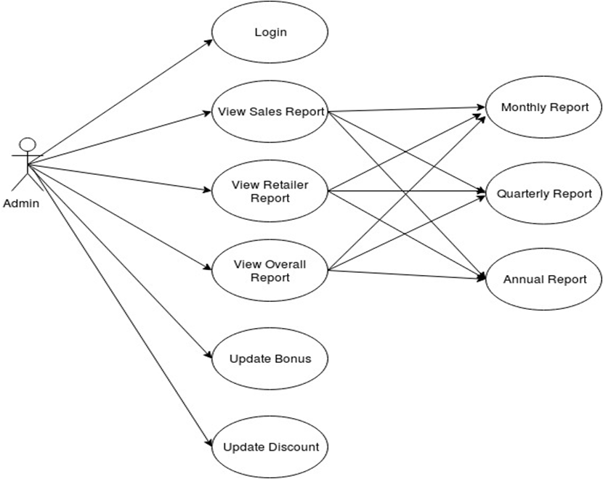
Use Case Diagram: Admin

Slide 5
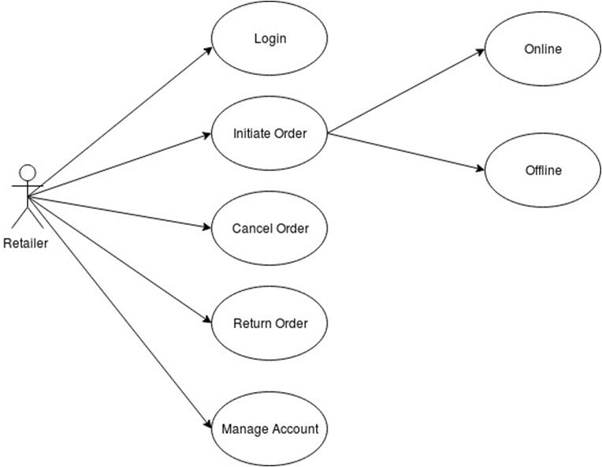
Use Case Diagram: Retailer

Slide 6
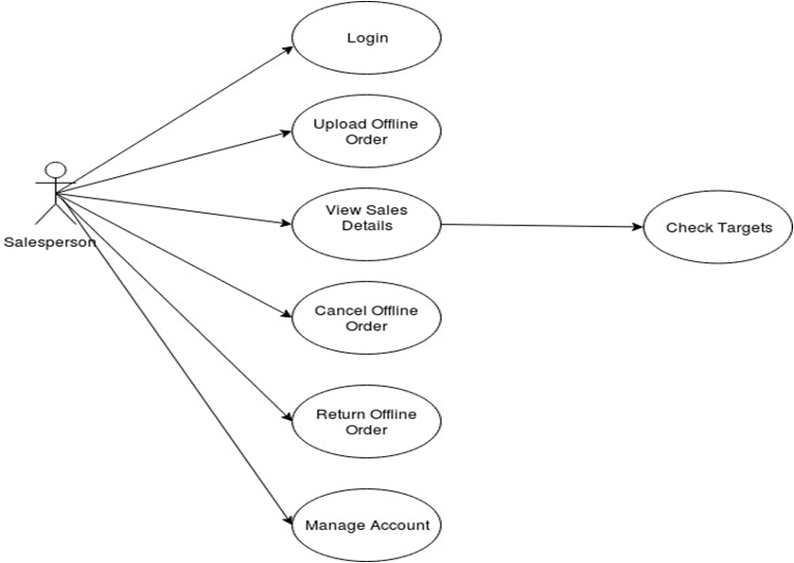
Use Case Diagram: Sales Person

Slide 7
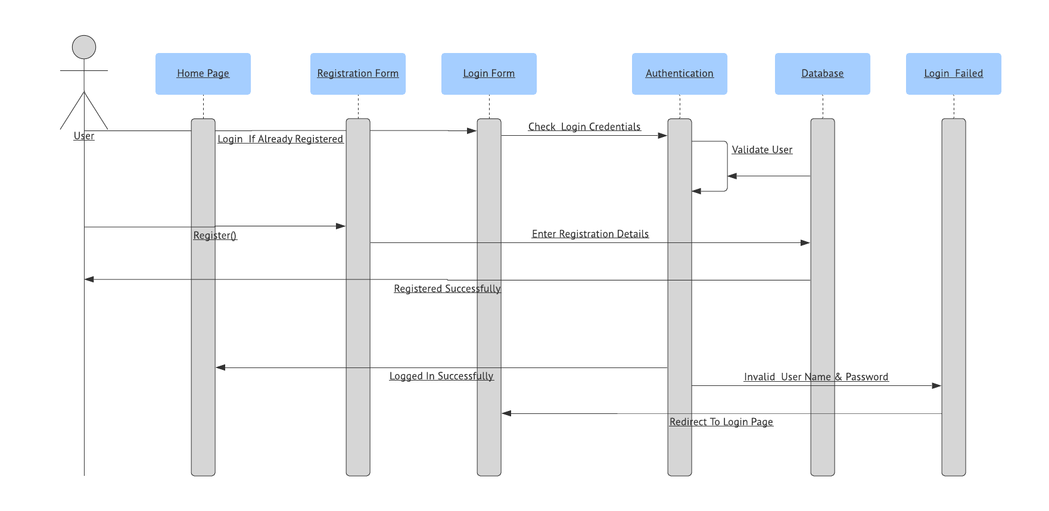
Sequence Diagram: Login

Slide 8
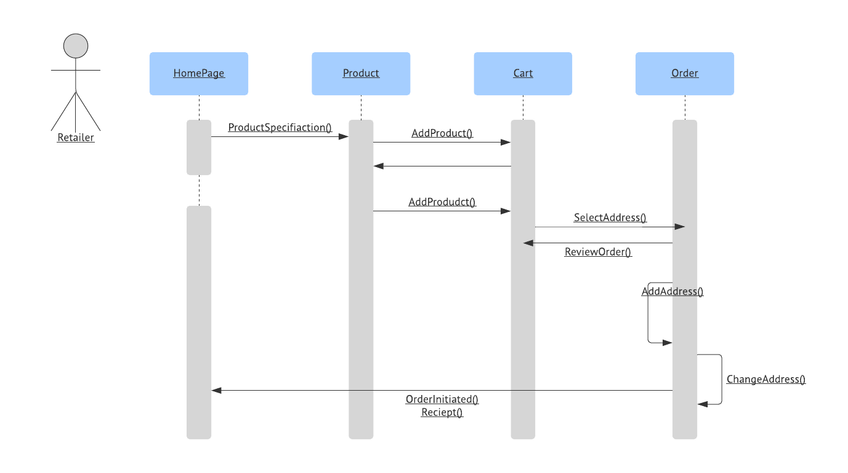
Sequence Diagram: Initiate Order

Slide 9
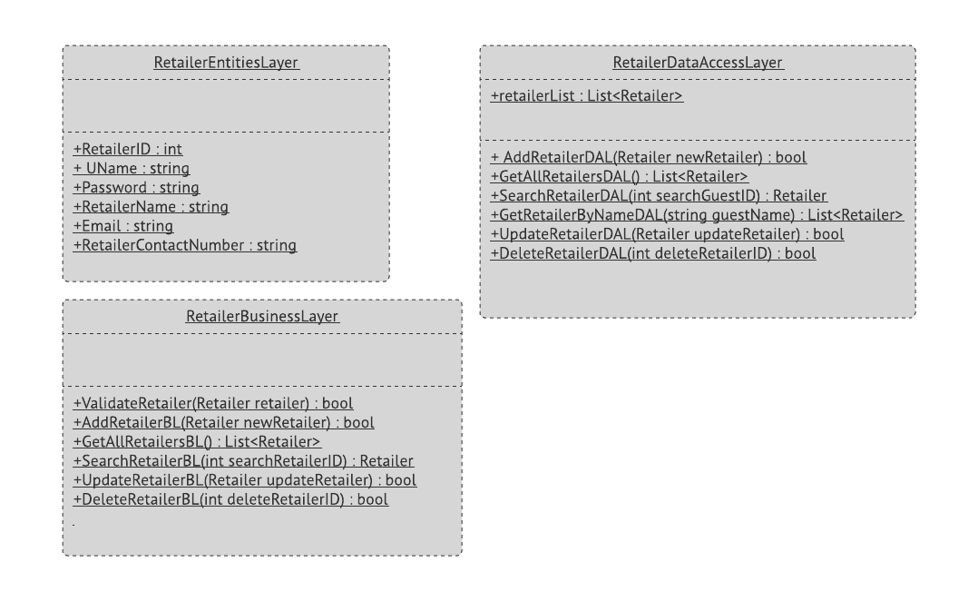
Class Diagram: Retailer

Slide 10
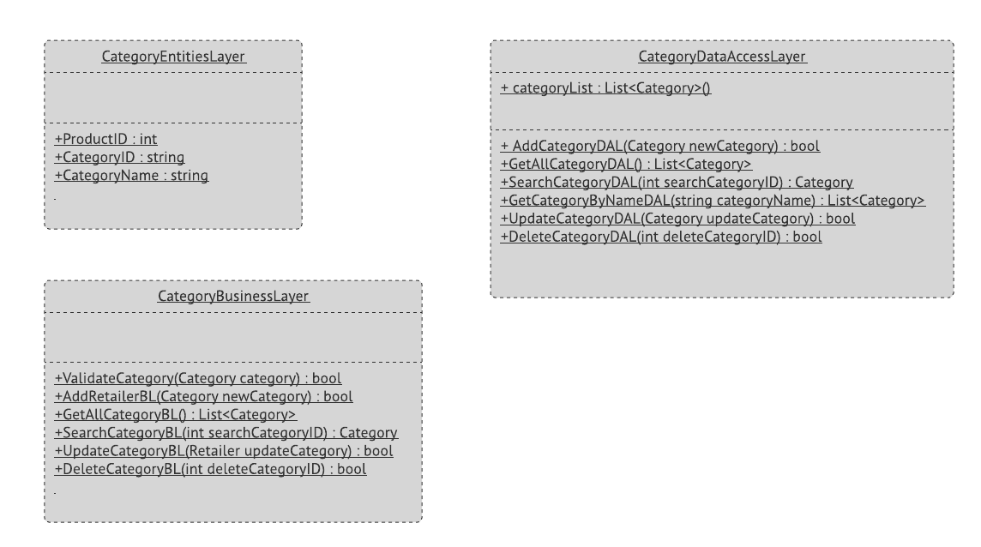
Class Diagram: Category

